Slide 1
Science & Creativity
Made by :-
Luvkush Sharma
Shikhar garg
Mohit sharma
Uday Pratap singh
Dheeraj sharma

Slide 2
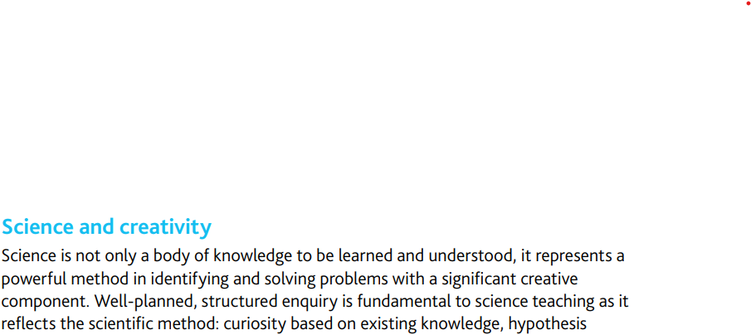
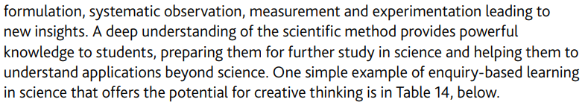
What is Science & Creativity ?

Slide 3
Creativity, the ability to make or otherwise bring into existence something new, whether a new solution to a problem, a new method or device, or a new artistic object or form.
High intelligence is common in creative persons, yet while they can meet the problems of life as rationally as anyone else can, their intellect does not rule at the expense of intuition or other seemingly nonrational influences. Most studies of the relationship of creativity to intelligence have also shown that extreme general intelligence does not necessarily kindle creativity. Findings such as these contributed to the “threshold” model of intelligence and creativity, which claims that, above a certain level, intelligence has little correlation with creativity—i.e., a highly intelligent person may not be as highly creative. It may be that intelligence sets the limits on the amount of information a person can learn and retain, while creative thinking provides the flexibility necessary for the original production of ideas.
Science is creative in much the same way that art, music, or literature are creative, in that scientists have to use their imagination to come up with explanations. These explanations are well informed – they are not mere guesses – but there is no escaping the fact that they are ultimately products of the imagination.

Slide 4
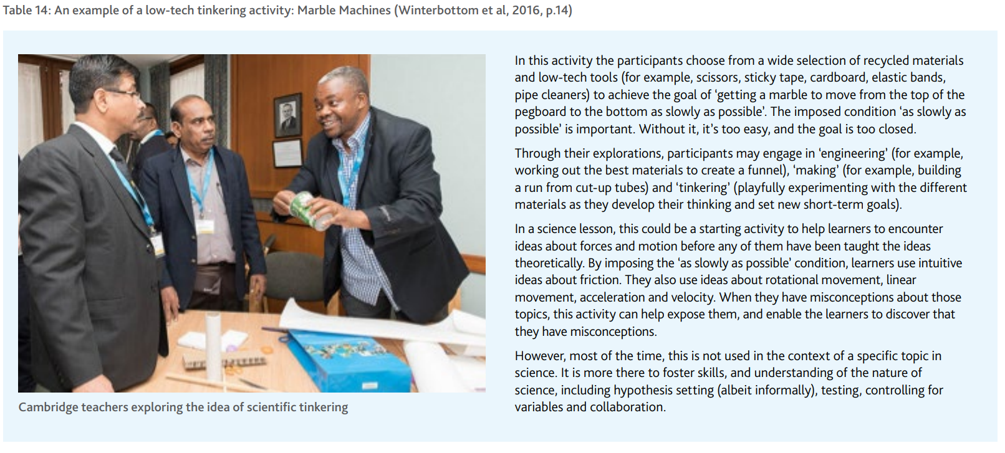

Slide 5
What can we learn from the arts?
Arts subjects such as art and design, music, drama and dance are often associated with creativity and innovation. A broad and balanced curriculum recognizes that encouraging the arts can help students to develop their own creative voice and creative thinking skills. Studying an arts subject can also build learners’ self-confidence as they feel valued for their unique contributions and talents. When encouraging creativity across the curriculum, it can be useful to look at the ideas and techniques that underpin the teaching of creative subjects such as art, drama and music.
Learner autonomy: Arts subjects can be popular with learners because of the perceived high level of learner choice that is involved. Learners often work on projects that they have devised themselves, according to their own interests and passions. Unique and original work is particularly valued, in both informal and formal assessments. When learners take control of their work in this way, their levels of intrinsic (internal) motivation tend to increase (Craft, 2005, p.56).

Slide 6
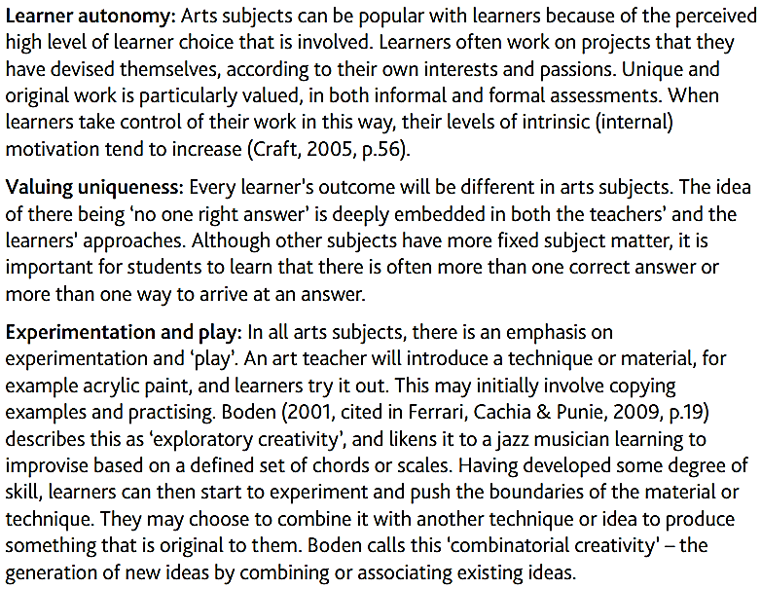

Slide 7
There are some more points :-
Looking at and discussing artworks: The study of artworks is not necessarily limited to art or art history lessons. Images of artworks can be used to prompt thinking in any subject area. Teachers can use carefully chosen artworks to prompt discussions and deeper critical thinking about a topic. Visual Thinking Strategies (VTS), developed by Yenawine (2014, p.25; see the Resources section) uses art to help learners of any age to develop their visual literacy, thinking and communication skills, and is an excellent resource.
The value of failure: The arts, perhaps more naturally than other subjects, accept and celebrate failure as a learning opportunity and understand that it is an inherent part of the creative process. As West-Knights (2017, p.49) points out: ‘One of the mainstays of drama classes… is the notion that mistakes are OK, as long as you are trying things out.’
Peer review and feedback: Peer review sessions (sometimes called group critiques) are commonly used in art and design as a method of informal interim assessment. Learners present their work to small groups of their peers and receive constructive feedback. The process is carefully scaffolded by the teacher, who leads initial sessions, modelling the types of questions and comments that are appropriate. When successful, peer reviewing helps learners to build independence, gain insight into their peers’ working and thinking processes, and develop confidence in themselves as creative individuals.

Slide 8
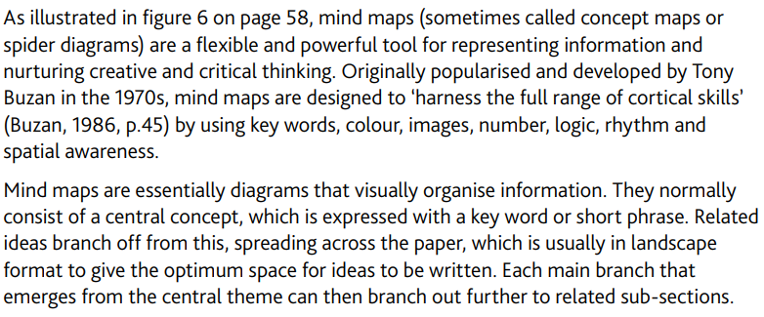
Making connections: mind mapping

Slide 9
MIND MAPS
Mind maps are an extremely versatile and accessible approach to help visualize and understand material. Many learners, including those who have dyslexia or other learning difficulties, find mind maps very useful, and they can be used to support learning in all disciplines. Research by Park and Brannon (2013, pp.2013–2019) found that training learners to use visual and spatial representations significantly improved their performance in mathematics, even when undertaking numerical problems. Research has shown that mind mapping is more effective as a means of knowledge retention and transfer than attending lectures, participating in class discussions or reading text passages alone

Slide 10
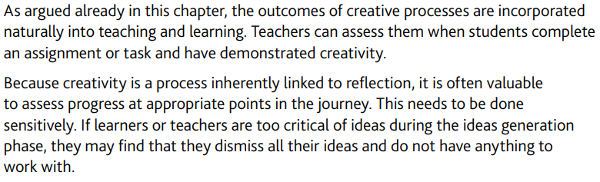
Assessing innovation and creativity

Slide 11
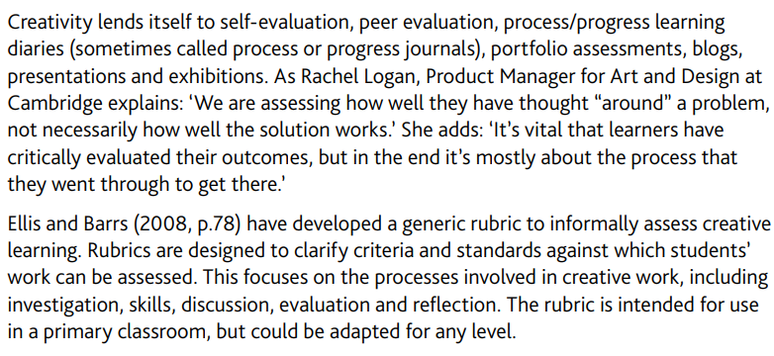

Slide 12


